Slide 1
X-Ray Diffraction
Dr. Ranjit Kumar
Department of Chemical Engineering
Email: ranjit.kumar@snu.edu.in

Slide 2
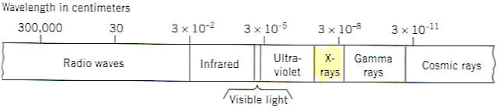
X-Ray Analysis
X-rays discovered in 1895
Fundamental to understanding of crystal structure and symmetry
Powder diffraction analyses are a simple and inexpensive method for identifying minerals, especially fine-grained minerals

Slide 3
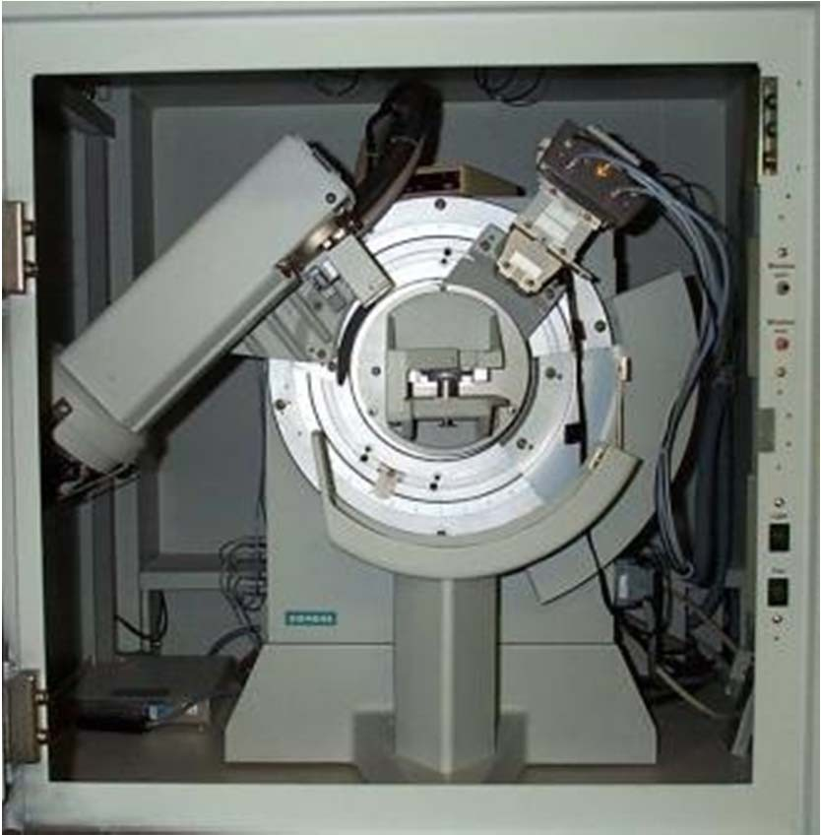
XRD practical aspects
How do we measure the X‐ray diffraction pattern of a solid?
Detector
Electron gun
Sample holder
Powder diffractometer

Slide 4
XRD basic theory
When will diffraction occur?
Diffraction
Sample
Sample
I₀
I_{t}
1 Å
X‐rays, electrons, neutrons
I₀ =>I_{t} ➔ transmittance
I₀ =>I_{t} ➔ diffraction and/or absorbance
Detector
The periodic lattice found in crystalline structures may act as a diffraction grating for wave‐ particles or electromagnetic radiation with wavelengths of a similar order of magnitude (10^{‐10} m or 1 Å).
For solids, there are three particles/waves with wavelengths equivalent to interatomic distances and, hence, which will interact with a specimen as they pass through it: X‐rays, electrons, and neutrons.

Slide 5




XRD basic theory
In materials with a crystalline structure, X‐rays scattered by ordered features will be scattered coherently “in‐phase” in certain directions meeting the criteria for constructive interference ➔ signal amplification.
The conditions required for constructive interference are determined by Bragg's law.
Incident radiation
“Reflected” radiation
Bragg’s Law
n λ = 2d sinθ
λ = X‐ray wavelength
d = distance between lattice planes
λ
θ
θ
θ = angle of incidence with lattice plane
n = integer
d
Transmitted radiation

Slide 6
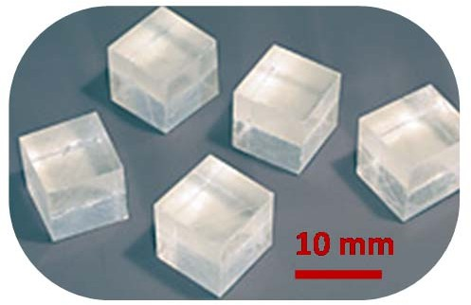
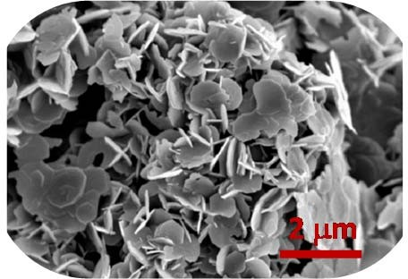
XRD basic theory
What type of materials can we study? Gas: No structural order – see nothing.
Liquid/Amorphous solids: Order over a few angstroms – broad diffraction peaks
Ordered solids: Extensive structural order – sharp diffraction peaks. Two types of ordered solids:
1) Single crystals
2) Polycrystalline powders
Large crystal required. Crystal orientation known.
➔ Each lattice plane only present in one orientation.
➔ No overlap of reflections.
➔ Reflection intensities may be accurately measured.
Most common in heterogeneous catalysis. Assume all crystal orientations present.
➔ Each lattice plane present at all orientations.
➔ Many overlapping peaks.
➔ Reflection intensities are difficult to determine.
18

Slide 7
XRD basic theory
What determines the intensity of the diffraction peak?
Electron density
X‐rays scattered by electrons
➔ Greater the atomic number, Z, the higher the scattering factor of a given element (directly proportional).
➔ Intensity proportional to sum of the scattering factors of atoms in a given lattice plane. I ∝ |F|²
Multiplicity
For Powder samples all planes with equivalent d‐spacing overlap.
➔ Intensity dependent on number of overlapping planes.

Slide 8
XRD basic theory
How can we satisfy the Bragg equation?
Bragg’s Law: nλ = 2dsinθ
To observe diffraction from a given lattice plane, Bragg’s law may be satisfied by varying either the wavelength, λ, or the Bragg angle, θ.
Monochromatic diffraction:
→ Vary θ
→ Bragg condition met once at a time.
With a fixed wavelength (laboratory source) data is collected as a function of increasing diffraction angle up to a given value of d (resolution dependent).
Laue diffraction:
→ Vary λ.
→ Bragg condition met many times simultaneously.
→ Faster but greater complexity in data analysis.
→ Requires synchrotron which is expensive.

Slide 9
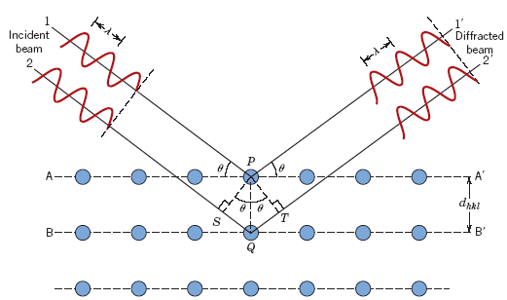
Bragg’s Equation
Interplanar spacing

Slide 10
Bragg’s Equation
nλ =
Where,
n = an integer, order of reflection
= 1 (unless stated otherwise)
Bragg’s law of diffraction
nλ = d_{hkl} sinθ + d_{hkl}sinθ
= 2d_{hkl} sinθ

Slide 11
For cubic system,
a²/d² = h² + k² + l²
X-Ray Diffraction
nλ =
= path difference where n = integer = 1
= d_{hkl} sinθ + d_{hkl}sinθ
= 2d_{hkl} sinθ
a²/d² = h² + k² + l²

Slide 12
Bragg’s Equation
λ = 2 d sinθ a²/d² = h² + k² + l²
λ = (2 a sinθ)/ √ (h² + k² + l²)
sin²θ = λ²(h² + k² + l²)/4a²
“ λ” and “a” are constants

Slide 13
Problem:
Given: {211} Planes
a_{Fe} = 0.2866 nm (2.866Å)
λ = 0.1542 nm (1.542Å)
Determine d_{hkl}, 2θ (diffraction angle)
n = 1
d_{hkl} = a/ √ (h² + k² + l²)
= 0.2866 nm /√ (2² + 1² + 1²)
= 0.1170 nm (1.170Å)
n =1
sinθ = n λ/2d_{hkl} =
θ = sin⁻¹(0.659) = 41.22°
2θ = 82.44°

Slide 14





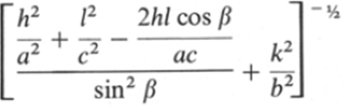
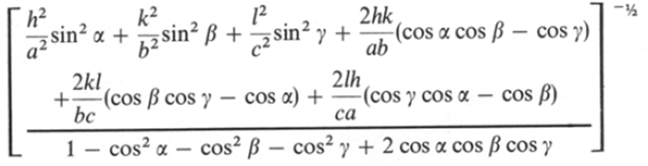
Relationship between d‐spacing and lattice constants
System
^{d}hkl
Cubic
Tetragonal
➔ Simplest for orthogonal crystal systems
Orthorhombic
Hexagonal Rhombohedral
Monoclinic
➔ Increasingly complex with decreasing symmetry.
Triclinic

Slide 15
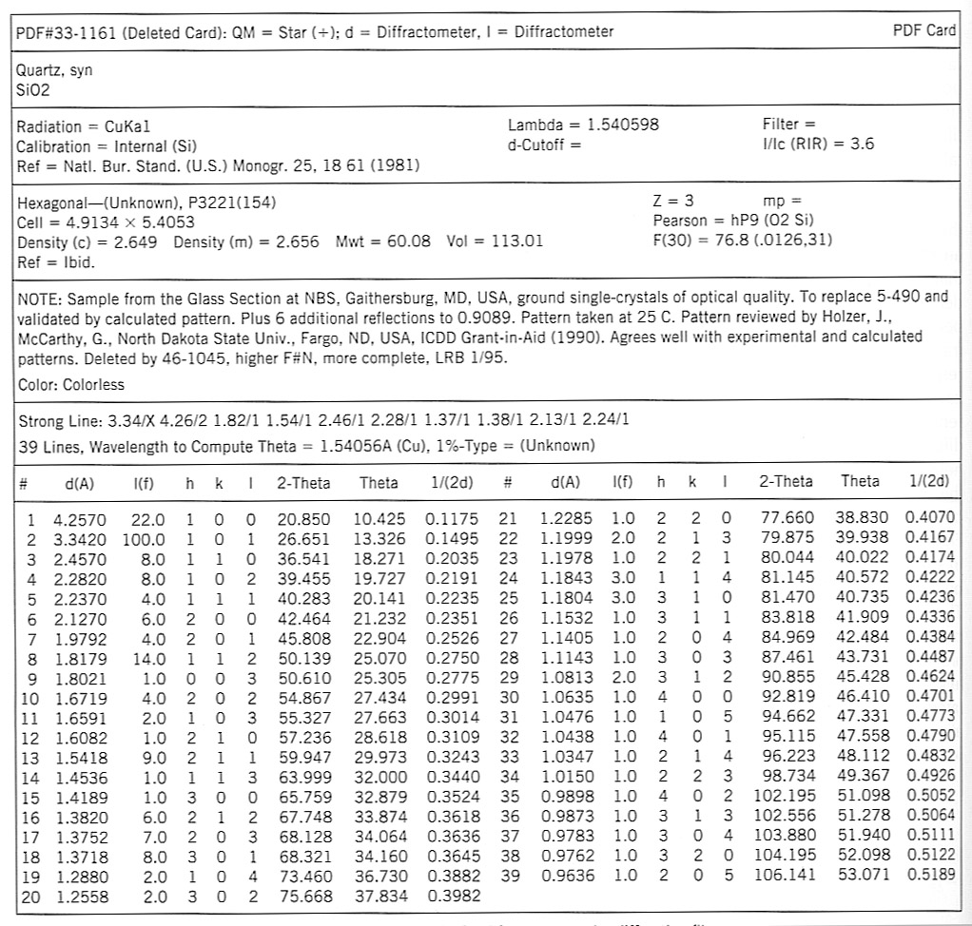

Slide 16
Selection / Extinction Rules
Bravais Lattice | Reflections which may be present | Reflections necessarily absent
Simple | all | None
Body centred | (h + k + l) even | (h + k + l) odd
Face centred | h, k and l unmixed | h, k and l mixed
End centred | h and k unmixed C centred | h and k mixed C centred
Bravais Lattice | Allowed Reflections
SC | All
BCC | (h + k + l) even
FCC | h, k and l unmixed
DC | h, k and l are all odd Or all are even & (h + k + l) divisible by 4

Slide 17
h² + k² + l² | SC | FCC | BCC | DC
1 | 100
2 | 110 |  | 110
3 | 111 | 111 |  | 111
4 | 200 | 200 | 200
5 | 210
6 | 211 |  | 211
7
8 | 220 | 220 | 220 | 220
9 | 300, 221
10 | 310 |  | 310
11 | 311 | 311 |  | 311
12 | 222 | 222 | 222
13 | 320
14 | 321 |  | 321
15
16 | 400 | 400 | 400 | 400
17 | 410, 322
18 | 411, 330 |  | 411, 330
19 | 331 | 331 |  | 331

Slide 18
Determination of Crystal Structure from 2θ versus Intensity Data
n | 2θ→ θ | Intensity | Sinθ | Sin²θ | ratio

Slide 19
 | 2θ→ θ | Intensity | Sinθ | Sin² θ | Simple ratio | Ratio
1 | 21.5 |  | 0.366 | 0.134 | 1 | 3
2 | 25 |  | 0.422 | 0.178 | 1.33 | 4
3 | 37 |  | 0.60 | 0.362 | 2.71 | 8
4 | 45 |  | 0.707 | 0.500 | 3.73 | 11
5 | 47 |  | 0.731 | 0.535 | 3.99 | 12
6 | 58 |  | 0.848 | 0.719 | 5.37 | 16
7 | 68 |  | 0.927 | 0.859 | 6.41 | 19
FCC

Slide 20
h² + k² + l² | SC | FCC | BCC | DC
1 | 100
2 | 110 |  | 110
3 | 111 | 111 |  | 111
4 | 200 | 200 | 200
5 | 210
6 | 211 |  | 211
7
8 | 220 | 220 | 220 | 220
9 | 300, 221
10 | 310 |  | 310
11 | 311 | 311 |  | 311
12 | 222 | 222 | 222
13 | 320
14 | 321 |  | 321
15
16 | 400 | 400 | 400 | 400
17 | 410, 322
18 | 411, 330 |  | 411, 330
19 | 331 | 331 |  | 331

Slide 21
The ratio of (h² + K² + l²) derived from extinction rules
SC | 1 | 2 | 3 | 4 | 5 | 6 | 8 | …
BCC | 2 | 4 | 6 | 8 | 10 | 12 | 14 | …
FCC | 3 | 4 | 8 | 11 | 12 | …
DC | 3 | 8 | 11 | 16 | …

Slide 22
Determination of Crystal Structure from 2θ versus Intensity Data
n | 2θ | θ | Sinθ | Sin² θ | ratio | Index | a (nm)
1 | 38.52 | 19.26 | 0.33 | 0.11 | 3 | 111 | 0.40448
2 | 44.76 | 22.38 | 0.38 | 0.14 | 4 | 200 | 0.40457
3 | 65.14 | 32.57 | 0.54 | 0.29 | 8 | 220 | 0.40471
4 | 78.26 | 39.13 | 0.63 | 0.40 | 11 | 311 | 0.40480
5 | 82.47 | 41.235 | 0.66 | 0.43 | 12 | 222 | 0.40480
6 | 99.11 | 49.555 | 0.76 | 0.58 | 16 | 400 | 0.40485
7 | 112.03 | 56.015 | 0.83 | 0.69 | 19 | 331 | 0.40491
8 | 116.60 | 58.3 | 0.85 | 0.72 | 20 | 420 | 0.40491
9 | 137.47 | 68.735 | 0.93 | 0.87 | 24 | 422 | 0.40494

Slide 23
Schematic of difference between the diffraction patterns of various phases
Crystal
Intensity →
0
90
180
Diffraction angle (2θ) →
Diffraction angle (2θ) →
Liquid / Amorphous solid
Intensity →
0
90
180

Slide 24
Crystallite size and Strain
Bragg’s equation assumes: ➢ Crystal is perfect and infinite ➢ Incident beam is perfectly parallel and monochromatic
Actual experimental conditions are different from these leading various kinds of deviations from Bragg’s condition ➢ Peaks are not ‘δ’ curves → Peaks are broadened
There are also deviations from the assumptions involved in the generating powder patterns ➢ Crystals may not be randomly oriented (textured sample) → Peak intensities are altered
In a powder sample if the crystallite size < 0.5 μm ➢ there are insufficient number of planes to build up a sharp diffraction pattern ⇒ peaks are broadened

Slide 25
XRD Line Broadening
Instrumental
Unresolved α₁ , α₂ peaks • Non-monochromaticity of the source (finite width of α peak)
Imperfect focusing
B_{i}
Crystallite size
In the vicinity of θ_{B} the −ve of Bragg’s equation not being satisfied
B_{c}
Strain
‘Residual Strain’ arising from dislocations, coherent precipitates etc. leading to broadening
B_{s}
Stacking fault
In principle every defect contributes to some broadening
Other defects

Slide 26
Applications of XRD
Bravais lattice determination
Lattice parameter determination
Determination of solvus line in phase diagrams
Long range order
Crystallite size and Strain
Density ( a³ = n M / N ρ )

Slide 27
Crystalline and Non-crystalline materials
Single crystal: No grain boundary
Polycrystalline: Several crystals
Anisotropy: Directionality in properties
Isotropy: No directionality

Slide 28
Problems
An X-ray beam of wavelength 0.71 Å is diffracted by a cubic KCl crystal of density 1.99x10³ Kg/m³. Calculate the interplanar spacing for (200) planes and the glancing angle for second order reflection from these planes. Mol. Wt. of KCl – 74.6 amu.
The Bragg’s angle for (220) reflection from nickel (FCC) is 38.2º when x-rays of wavelength 1.54 Å are employed in a diffraction experiment. Determine the lattice parameter of nickel.
Aluminium powder gives a diffraction pattern that yields the following eight largest d-spacings: 2.338, 2.024, 1.431, 1.221, 1.169, 1.0124, 0.9289 and 0.9055 Å. Aluminium has a cubic close packed structure and its atomic weight is 26.98 and 𝜆 = 1.5405 Å. What crystal system aluminium belongs to? Index the diffraction data.
The diffraction pattern of copper metal was measured with x-ray radiation of wavelength of 1.315Å. The first order Bragg diffraction peak was found at an angle 2θ of 50.5 degrees. Calculate the spacing between the diffracting planes in the copper metal. Index the peak.

Slide 29
Additional Information

Slide 30
Intensity of the Scattered electrons
Scattering by a crystal
A
Electron
Polarization factor
B
Atom
Atomic scattering factor (f)
C
Unit cell (uc)
Structure factor (F)

Slide 31
Structure factor calculations
Simple Cubic
A
Atom at (0,0,0) and equivalent positions
⇒ F is independent of the scattering plane (h k l)

Slide 32
B
C- centred Orthorhombic
Atom at (0,0,0) & (½, ½, 0) and equivalent positions
Real
(h + k) even
Both even or both odd
e.g. (001), (110), (112); (021), (022), (023)
Mixture of odd and even
(h + k) odd
e.g. (100), (101), (102); (031), (032), (033)
⇒ F is independent of the ‘l’ index

Slide 33
Relationship between
d and lattice constant for cubic system
Z
C
M
N
γ’
β’
α’
O
Y
B
A
X

Slide 34
From figure in a cubic lattice of
cube edge ‘a’ the intercepts of the
plane of the three axes are given by
OA = a/h
OB = a/k
OC = a/l
---- (1)

Slide 35
Let ON = d₁ = perpendicular distance from the origin
to the plane and the direction cosines of ON be
Cos α’, Cosβ’ & Cosγ’ .
Cosα’ = ON/OA = d₁/a/h = d₁h/a
Cosβ’ = ON/OB = d₁/a/k = d₁k/a
Cosγ’ = ON/OC = d₁/a/l = d₁l /a
--- (2)

Slide 36
But,
Cos²α’ + cos²β’ +cos²γ’ = 1 --- (3)
Substituting eq(3) in eq(2), we get
(d₁h/a)² + (d₁ k/a)² + (d₁ l/a)² = 1
(OR)
d₁ = ON = a/√h² + k² + l² -- (4)

Slide 37
Let ‘OM’ be the perpendicular distance of the next
parallel plane from the origin.
Hence, its intercepts are
OM = d₁ + d₁ = 2d₁
= 2a/√ h² + k² + l² --- (5)

Slide 38
Therefore, the interfacing between two
adjacent planes is equal to
OM – ON = NM
Hence,
NM = 2d₁ – d₁ = d₁
d₁= a/ √h² + k² + l² -----(6)
Eq(6) gives the interplanar spacing between
two adjacent parallel planes of Miller Indices.

